Slide 1
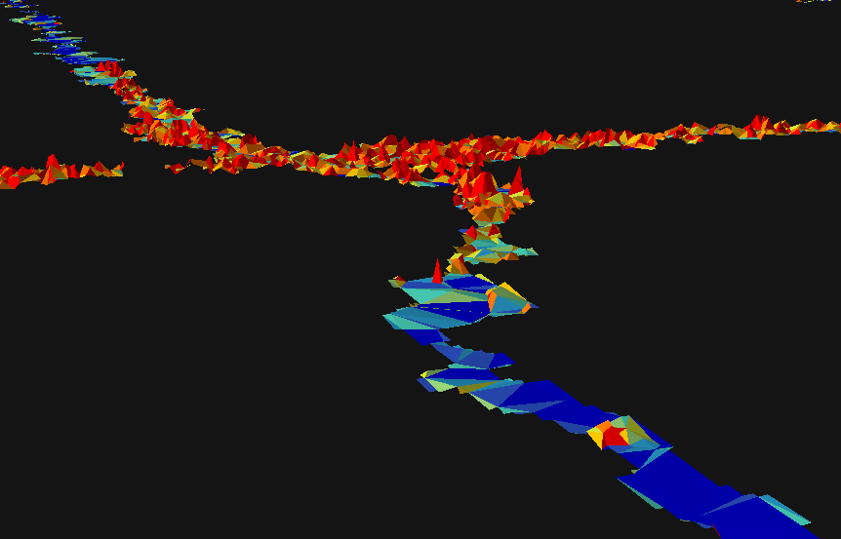

Seismic Line Mapper Demo
BERA SLM demo (January, 2020)

Slide 2
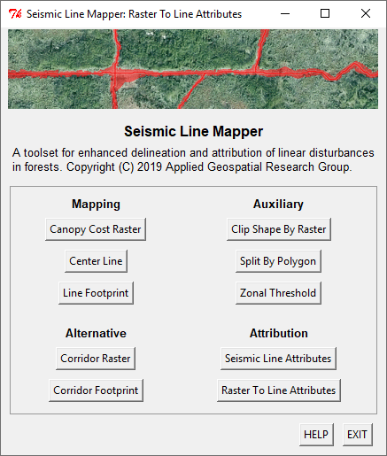
Line mapping

Slide 3
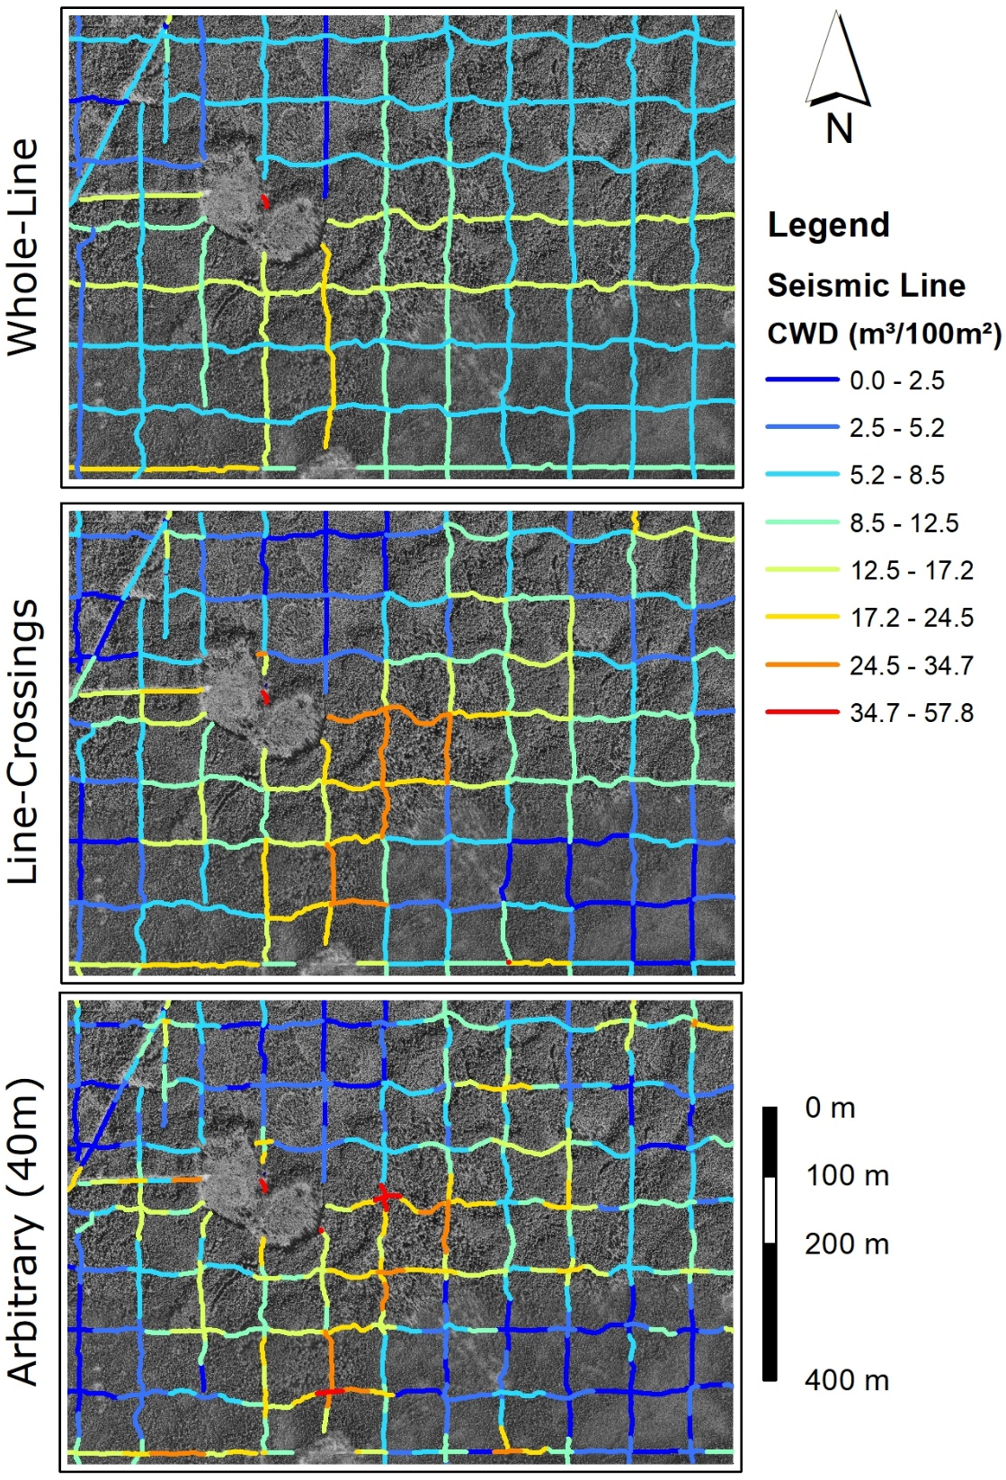
Line attribution
Segmentation options
Whole-line
Line-Crossings
Arbitrary

Slide 4

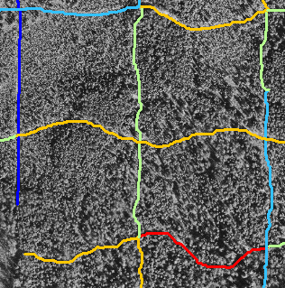
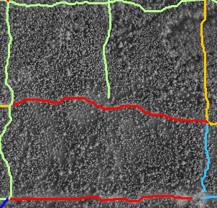
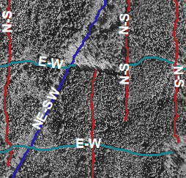
Internal attributes – line properties
Length
(meters)
Bearing / Orientation
(degrees / labels)
Sinuosity
(dimensionless)
Small
Large
Low
High

Slide 5
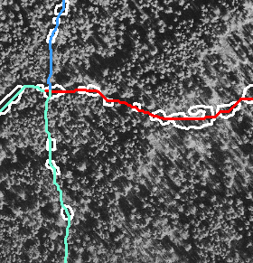
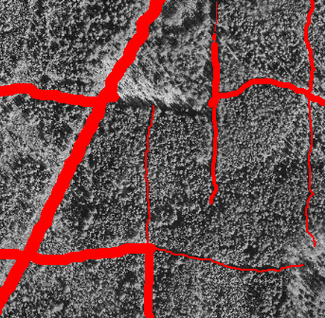
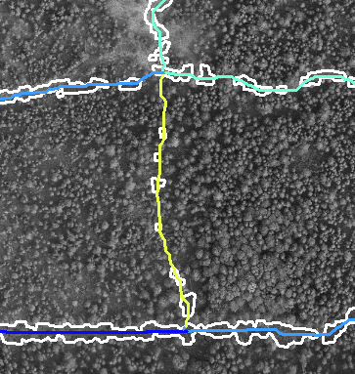
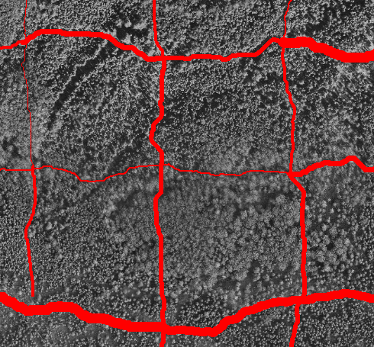
Internal attributes – footprint properties
Area
(m²)
Average width
(m)
Perimeter
(m)
Fragmentation
(Perimeter/Area, m⁻¹)
Small
Large
Low
High

Slide 6
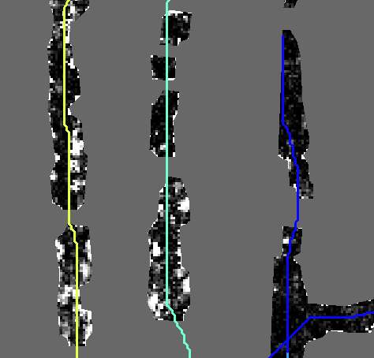
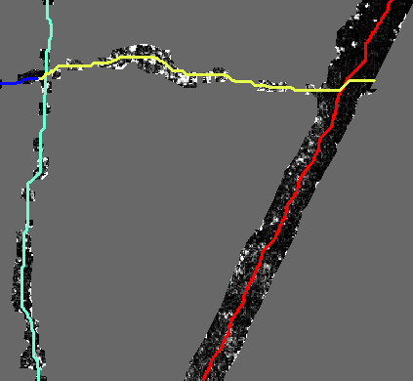
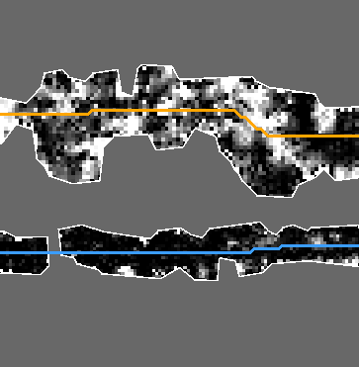
Internal attributes – CHM properties
Average Vegetation Height (m)
Vegetation Volume
(m³)
Vegetation Roughness
(RMSH, m)
Low
High

Slide 7
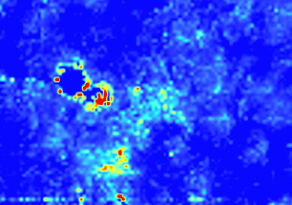
External attributes
User-provided raster
(e.g. CWD volume - m³/100m²)

Slide 8
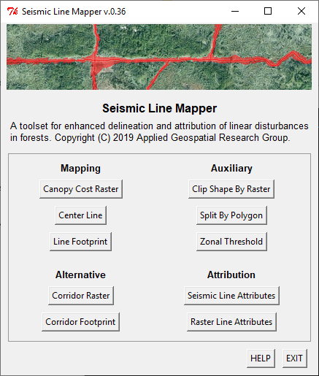
Step by step
Mapping
Attribution
1
0
2
2.5a
3
2.5b
3a
4
3b
5

Slide 9
Mapping Tools
TOOL
Canopy Cost Raster
Center Line
Line Footprint
INPUT
CHM
Cost Raster + Input Lines
Canopy Raster + Cost Raster + Center Lines
OUTPUT
Canopy Raster + Cost Raster
Center Lines
Footprint Polygons

Slide 10
Attribute Tools
TOOL
Seismic Line Attributes
Raster Line Attributes
INPUT
CHM + Center Lines + Footprint
Center Lines + External Raster
OUTPUT
Attributed Lines
Attributed Lines

Slide 11
Possibilities
Management Planning
Policies
Models (Wildlife, Regeneration)
Regression
Classification

Slide 12
Summary
Inputs
CHM
Regional Lines
Outputs
Detailed Lines
Polygons
Attributes
Line (size & shape)
Footprint (size & shape)
Microtopography
Surrounding Forest
External Variables

